Slide 1
Creating a General Mission Statement for an Organization
Name
Institution
Date

Slide 2
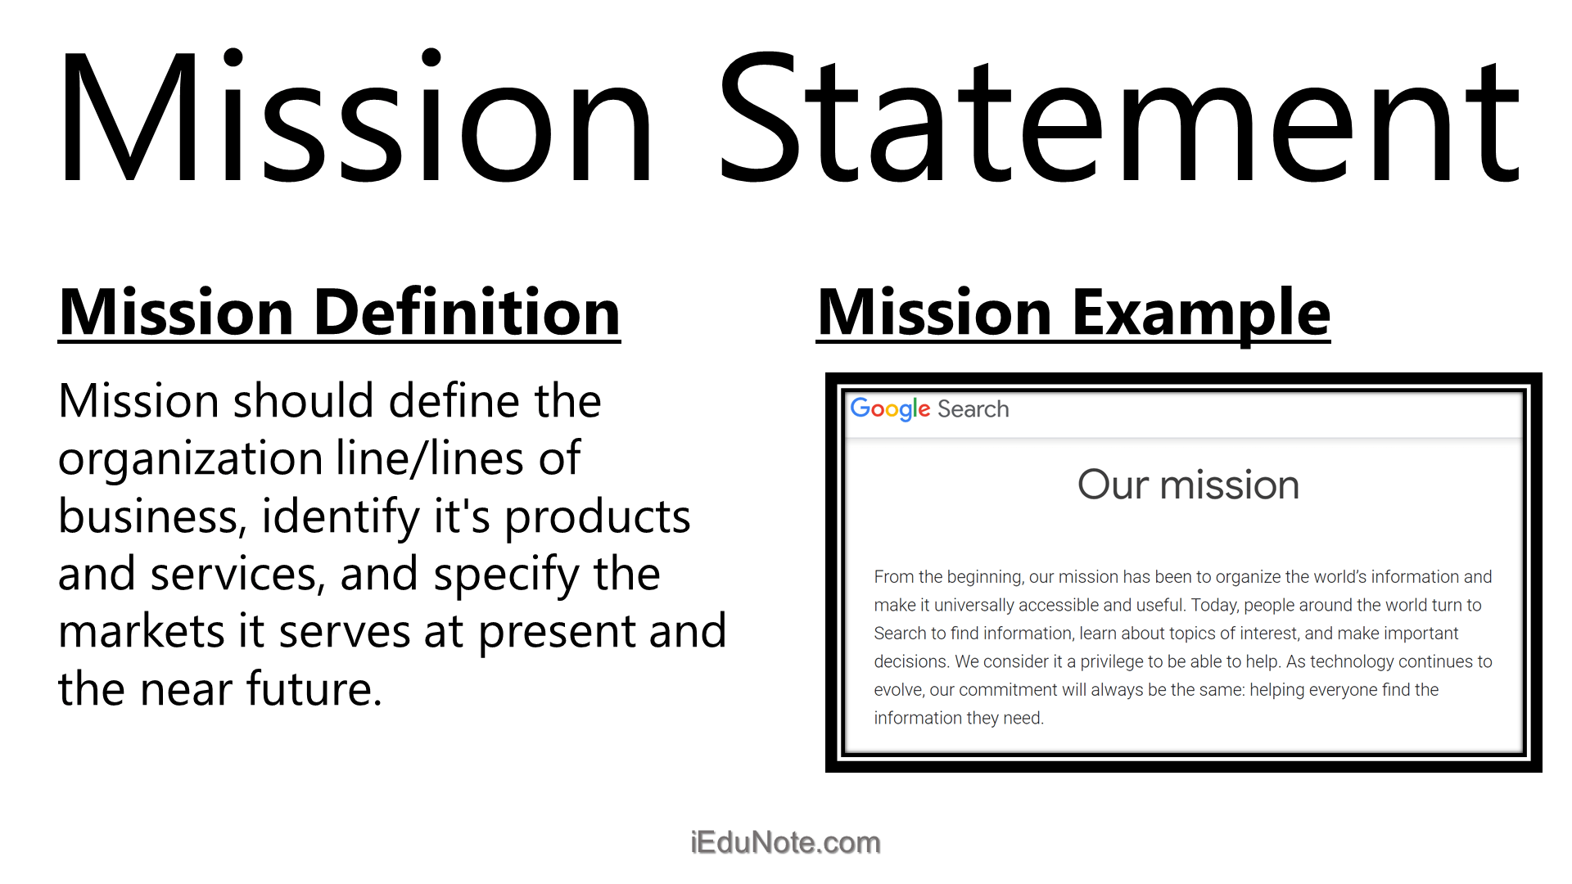
Introduction
Every one of us here has an aim regarding the organization he or she is working for and the personal aims should be in line with the aims of the company.
The organizations should as well have their own aims well outlined in the mission statement.
The mission statement is a formal summary of the aims and values of a company, enterprise, or individual.
With a mission statement, the company aims are clearly defined and thus performance of the company duties is made easy (Alegre et al., 2018).
The management and leadership of a company are keeping its workers directed towards achieving certain goals.
Notes:
Every one of us here has an aim regarding the organization he or she is working for and the personal aims should be in line with the aims of the company. The organizations should as well have their own aims well outlined in the mission statement. The mission statement is a formal summary of the aims and values of a company, enterprise, or individual. With a mission statement, the company aims are clearly defined and thus performance of the company duties is made easy (Alegre et al., 2018). The management and leadership of a company are keeping its workers directed towards achieving certain goals.

Slide 3

The Basic Three Parts of a Mission Statement
For the mission statement to be developed well, there are basic components that should be included.
In the first place, one needs to consider the market as the target audience.
The second critical aspect is the contribution and this focuses on, the product offered by the company or the services provided that should be clearly highlighted in the mission statement.
According to Gächter & Renner (2018), distinction focuses on the main focus is on describing what makes the product more unique and the primary reasons the audience should buy it over another.
The failure to include the above three mentioned parts in the mission statements makes it faulty and less impactful in improving the organizational performance.
Notes:
For the mission statement to be developed well, there are basic components that should be included In the first place, one needs to consider the market as the target audience. The second critical aspect is the contribution and this focuses on, the product offered by the company or the services provided that should be clearly highlighted in the mission statement. According to Gächter & Renner (2018), distinction focuses on the main focus is on describing what makes the product more unique and the primary reasons the audience should buy it over another. The failure to include the above three mentioned parts in the mission statements makes it faulty and less impactful in improving the organizational performance.

Slide 4
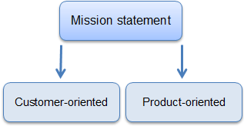
Mission Vs Vision Statement
It is worth noting that all organizations need both mission and vision statements to remind the worker and all the stakeholders of the purpose of the organization.
There are people who try to interchange the mission and vision statements by the truth remains that they are not interchangeable.
Both the statements reflect on the purpose and the goals of a company although they serve different purposes.
The mission statement serves as a critical roadmap to achieving the vision statement (Pencoet et al., 2017).
The vision statements serve as guidance for the business to achieve its aspirations. The visions and mission statements should be written separately.
Notes:
It is worth noting that all organizations need both mission and vision statements to remind the worker and all the stakeholders of the purpose of the organization. There are people who try to interchange the mission and vision statements by the truth remains that they are not interchangeable. Both the statements reflect on the purpose and the goals of a company although they serve different purposes. The mission statement serves as a critical roadmap to achieving the vision statement (Pencoet et al., 2017). The vision statements serve as guidance for the business to achieve its aspirations. The visions and mission statements should be written separately.

Slide 5
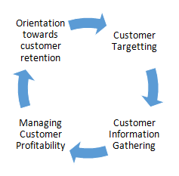
Writing a Great Mission Statement
Writing the company’s mission statement gives the person an opportunity to express the organizational goals, ethics, culture, and norms for decision making. The steps for writing a mission statement are;
Defining the market with a story.
Explaining what the business does for customers.
Describing what the business does for its employees.
Outlining the significance of the business to its owners.
The last step is discussing, digesting polishing, and revising the mission statement.
Notes:
Writing the company’s mission statement gives the person an opportunity to express the organizational goals, ethics, culture, and norms for decision making. The steps for writing a mission statement are; Defining the market with a story for all the state holders to understand. As well, one should explain what the business does for customers (Zahan & Sultana, 2019). Consumers make a very critical part of any organization and thus they should be well informed of the dealings of the company. Besides, the mission statement should describe what the business does for its employees, outlining the significance of the business to its owners and the last step is discussing, digesting polishing, and revising the mission statement.

Slide 6
Importance of Mission Statement
The mission statement helps the employees to know what they are expected to do in the organization (Penco et al., 2017).
With the mission statement, the employees get to see the positive aspects of their daily activities.
Missions statement is essential in boosting morale and developing a positive workplace culture.
The employees get to know the benefits they might realize from the mission statement.
Notes:
The mission statement helps the employees to know what they are expected to do in the organization. With the mission statement, the employees get to see the positive aspects of their daily activities. In addition, the mission statement is essential in boosting morale and developing a positive workplace culture (Penco et al., 2017). The employees get to know the benefits they might realize from the mission statement and thus I feel that all the organizations focusing on success need to have well-outlined mission statements.

Slide 7
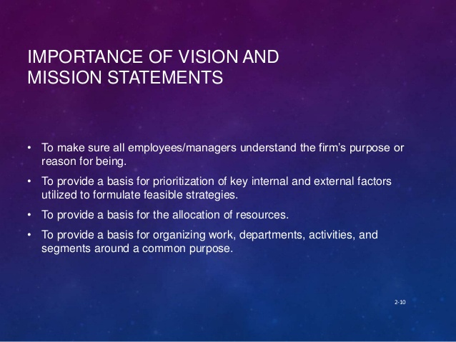
Roles of Managers in Developing Mission Statement
The success of many organizations is based on the managers available, their managerial skills, and their commitment to saving improve the performance.
Managers should have great knowledge on developing the mission statements and constantly reminding the workers of their roles in the company.
Communicating to the subordinates on the significance of the mission statement.
Giving society a better understanding of the organization.
Featuring all the critical aspects of the organization in the mission statement.
Notes:
The success of many organizations is based on the managers available, their managerial skills, and their commitment to saving improve the performance. Managers should have great knowledge on developing the mission statements and constantly reminding the workers of their roles in the company. Communicating to the subordinates on the significance of the mission statement. Giving society a better understanding of the organization. Featuring all the critical aspects of the organization in the mission statement.

Slide 8
Summary
Definition of mission statement
The basic parts of the mission statement.
Mission Vs. vision statement.
Writing a great mission statement.
Importance of mission statement.
Roles of managers in developing mission statements.
Notes:
In summation, it is essential for all of us to understand all the aspects of the mission statement including; definition of the mission statement, the basic parts of the mission statement, compare and contrast the Mission Vs. vision statement. As well, writing a great mission statement, constant remembering of the importance of mission statement, and examining the roles of managers in developing mission statements.

